Slide 1
E-FARMERS
- By Team CHEAP CODERS

Slide 2
Reality:
Farmers who are considered Backbone of our Nation are not receiving the expected worth for their work.
The main reason for it is the following chain:
Farmers -> APMC -> Local Mandi -> Retailer -> Consumer
In between the farmers and consumers there is a long gap. In this gap many other persons are getting benefited, their benefit is loss to both farmers as well as to consumers(FMCG’s). Products are being bought from the farmers at lower prices and are sold to the customers at higher prices.
What happens if we create an interface where consumer(farm output buyers) and farmers have a direct interaction there by eliminating the middle persons?
What if, we there is an option where farmer can also directly interact with manufacturers to buy fertilizers and other farm producing inputs?

Slide 3
Idea:
Our idea is to provide an interface to the three main bodies i.e.,
Manufacturers of Fertilizers
Farmers
Big Buyers
Interaction between the three:
Farmers can directly sell their produced goods to the Big Buyers and can also buy fertilizers and other inputs required for the crop without any middle person.
Manufacturers
Farmers
FMCG’s

Slide 4
Login for Farmers :
Farmers are provided with two options
Buy farm inputs
Sell products
To buy Inputs:
After selecting this option farmer has to choose
The crop that he is producing
Type of soil on which the crop is being produced
Amount of crop
Based on the above details ,some fertilizers are shown ,so that farmer can select the fertilizer that he need.
After that, he can join any of the pools that he is interested in or he can create new pool and wait for other farmers to join his pool near his location and place his order after reaching target quantity.
Company after accepting the order, delivers the goods to the farmers.

Slide 5
Login for Farmers: (cont..)
To sell their farm products :
Farmer has to choose:
Type of Crop
Estimated amount of yield
Based on the options provided, he can see the list of all the buyers of the crop and bid his crop, so that he could maximize the profit.
He can join the pool of other farmers at his location who are willing to sell the same crop at same bid rate.
There will be an Escrow mechanism which establishes an agreement between farmers and other two bodies(input manufacturers and farm output consumers) by the third party(Kisan Forum Pvt Ltd).

Slide 6

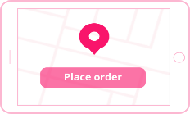

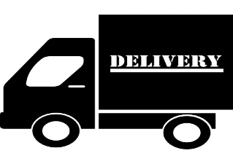

Login for Manufacturers:
They can see the list of all the orders that come from various locations and send the inputs to their locations exactly.
Delivered inputs can be distributed among eachother(farmers present in pool) at some specific location.
Escrow
Holder
Pool of farmers
Crop Input
Manufacturers

Slide 7
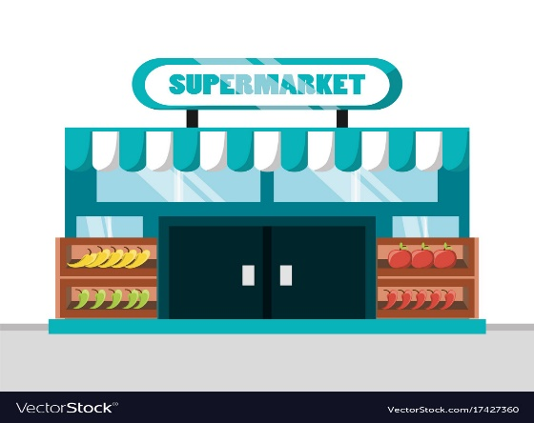


Login for Big Buyers:
Big buyers can provide their bid rate for the different farm products.
When the pool of farmers and Big Buyers agree upon each other with the same bid rate, then farmers will sell their farm production to the respective buyer.
Farm selling pool can alone take the responsibility of transportation by taking the address and details of the Buyer or the pool can accept the transportation provided by the Buyer at some cost.
Escrow
Holder
Escrow
Holder
Pool of farmers
Farm Buyers

Slide 8
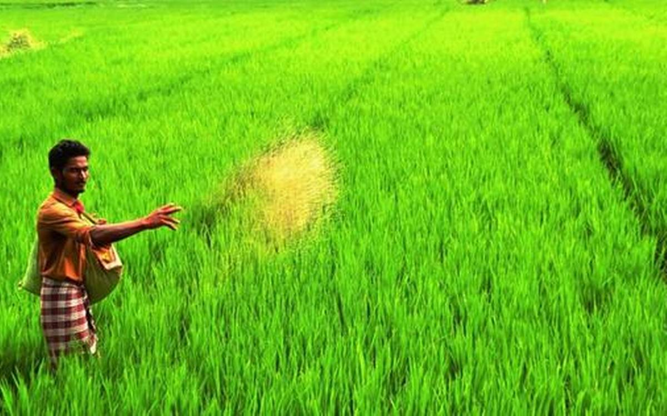
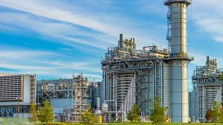
Farmer Interact With Industry:
Farmer Industry

Slide 9
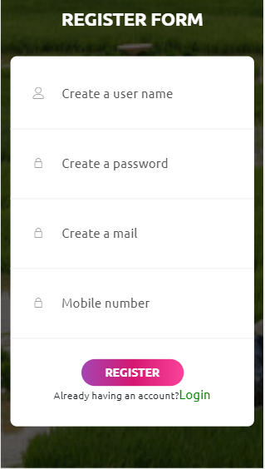
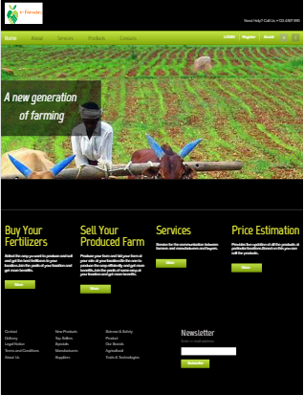
User Interface
Note: This is just for reference only.

Slide 10
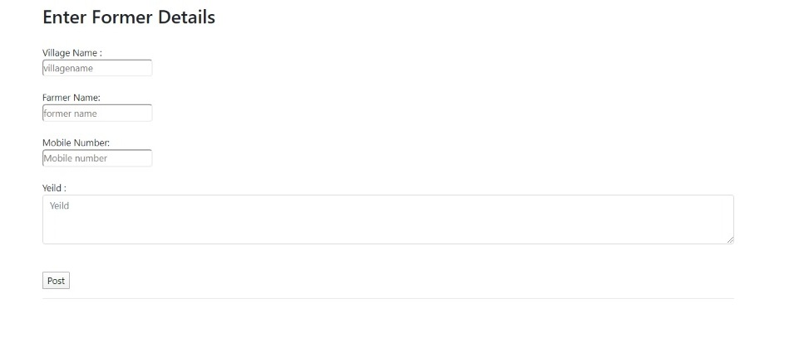
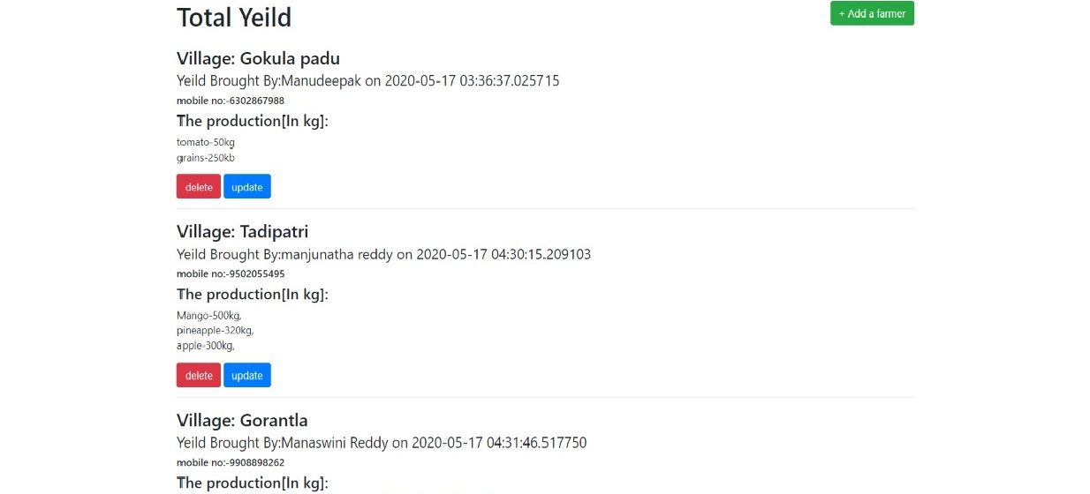
Farmer And Industry Interface:

Slide 11
Technology Stack:
Android Studio (java)
Web Technologies like PYTHON-FLASK, HTML, CSS, JAVA SCRIPT.
SQL-ALCHEMY

Slide 12
DataBase schema:
pk:Primary Key
fk:Foreign Key
Group
Admin
Farmer
Crop
Fertilizer
gid(pk)
gname
adid(fk)
adid(pk)
adlocx
Adlocy
Fid(fk)
gid(fk)
cid(pk)
cname
ctype
ferid(pk)
fername
feramt
ferusage
gid(pk)
gname
adid(fk)
Fercompany
Buyer
Group(far-fert)
Far-crop
Fert-crop
fcid(pk)
fcname
fcphone
fcmail
fcDesc
bid(pk)
bname
btype
bphone
bgmail
bDes
gffid(fk)
fid(fk)
cid(fk)
ferreq
ferid(fk)
cid(fk)
fcid(fk)
fid(fk)
cid(fk)
gid(fk)
fid(fk)
cid(fk)
cproduction
Grade
Buy-crop
Group(farmer-buyer)
bid(fk)
gname
gcost
bid(fk)
cid(fk)
quan-req

Slide 13
Use Cases:
This portal will be used by all the three main bodies of Agriculture.
Works in Android Environment and all browsers.

Slide 14
Dependencies and Show Stopper :
Application with an internet access.
Awareness must be created for farmers regarding this.

Slide 15


